Slide 1


Data Structure
Course Code : ENCS205
Dr Swati Gupta
Associate Professor, School of Engineering & Technology
K.R. Mangalam University
Unit 3 :Trees and Graphs
Notes:
New Courses replaced with New Programmes

Slide 2

AVL TREES
Session 50
Introduction to AVL Trees
Properties of AVL
Constructing AVL
Operations on AVL
Brainstorming Session
Notes:
New Courses replaced with New Programmes

Slide 3
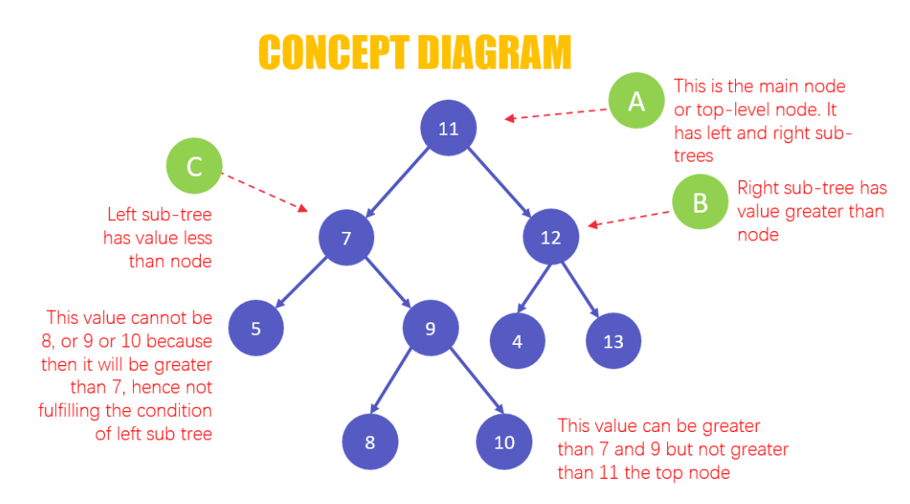
RECAP
A binary search tree(BST) is a special type of binary tree where two properties are obeyed:
The value of the left node is less than the value of the
parent node.
The value of the right node is greater than the value of the parent node.
Notes:
New Courses replaced with New Programmes

Slide 4

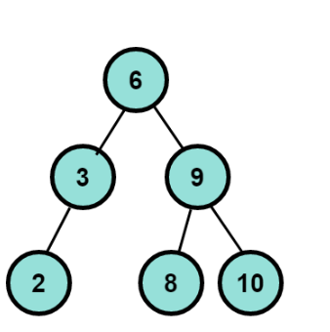
AVL Trees
AVL tree stands for Adelson, Velskii & Landis Tree, and it an extension of the binary search tree data structure.
It is an height balanced binary search tree in which each node is associated with a balance factor
Notes:
New Courses replaced with New Programmes

Slide 5
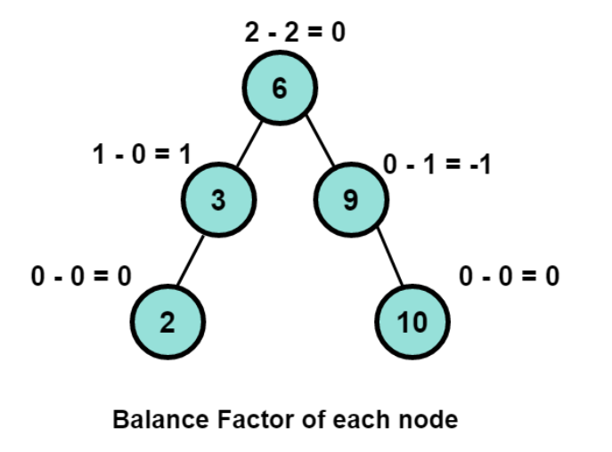
Balance Factor AVL tree
The balanced factor should be -1, 0 or +1. Otherwise, the tree will be considered an unbalanced tree.
Let’s look at an example tree that shows the balance factor of each node
Notes:
New Courses replaced with New Programmes

Slide 6
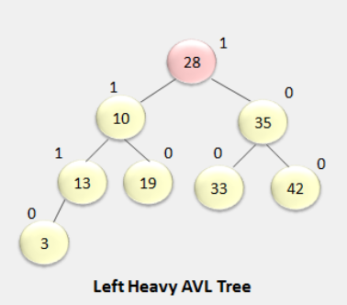
Properties of Balance Factor AVL tree
Property 1: If a subtree has a balance factor>0,
then the subtree is called left-heavy as the height of the
left subtree is greater than the height of its right subtree
The left subtree has more nodes than the right subtree.
Notes:
New Courses replaced with New Programmes

Slide 7
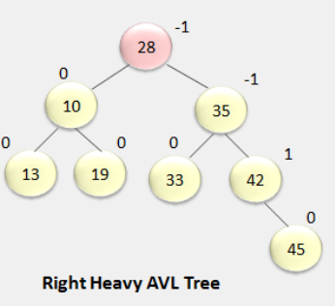
Properties of Balance Factor AVL tree
Property 2: If a subtree has a balance factor<0, then the subtree is called right-heavy as the height of the left subtree is smaller than the height of its right subtree.
The right subtree has more nodes than the right subtree.
Notes:
New Courses replaced with New Programmes

Slide 8
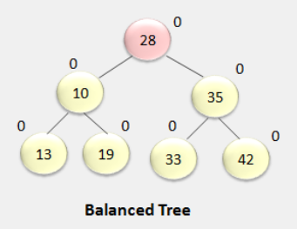
Properties of Balance Factor AVL tree
Property 3: If the balance factor=0, the subtree is perfectly balanced, with both left and right subtrees having equal heights.
Notes:
New Courses replaced with New Programmes

Slide 9
Application of AVL tree
AVL trees are beneficial when designing some database applications where the number of insertions and deletions is less than search operations.
AVL Trees are used for all sorts of in-memory collections such as sets and dictionaries.
Example: Railway databases can take advantage of AVL Trees as new trains are seldom added, whereas many people often search for the available list of trains.
Notes:
New Courses replaced with New Programmes

Slide 10
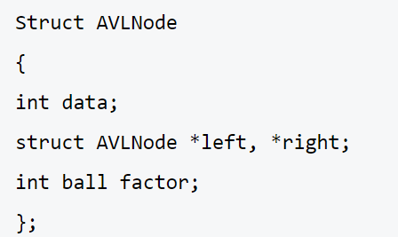
Node Structure of an AVL tree
Notes:
New Courses replaced with New Programmes

Slide 11

Operations on AVL Tree
Deletion Operation
Insertion Operation

Slide 12
Insertion in AVL tree
1. Insert Like a BST: Start by inserting the node as you would in a standard BST.
2. Check for Balance: After insertion, walk back up the tree (towards the root) and check the balance factor of each node .The balance factor should be -1, 0, or 1.
3. Rotate if Necessary: If a node is found with a balance factor of -2 or 2, perform rotations to balance the tree
Notes:
New Courses replaced with New Programmes

Slide 13
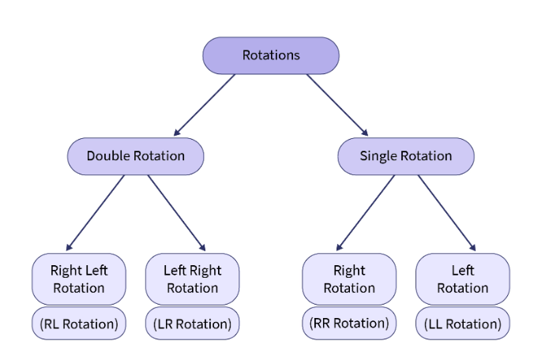
AVL tree Rotations
Notes:
New Courses replaced with New Programmes

Slide 14
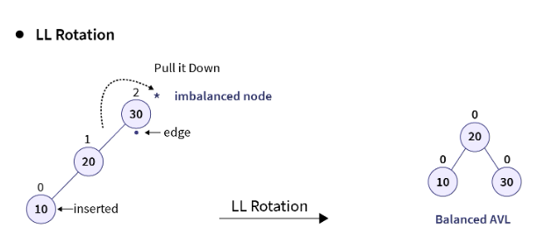
LL Rotation in AVL tree
LL Rotation is a single rotation operation executed when the tree becomes unbalanced due to the insertion of a node into the left subtree of the left child of the node causing the imbalance, known as Left-Left (LL) insertion
This imbalance indicates that the tree is heavy on the left side. Hence, a right rotation (or clockwise rotation) is applied
Notes:
New Courses replaced with New Programmes

Slide 15
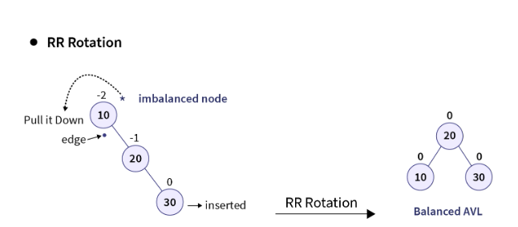
RR Rotation in AVL tree
Tree becomes right heavy and a left rotation (or anti-clockwise rotation) is performed along the edge of the imbalanced node to counter this right skewness caused by the insertion operation.
Notes:
New Courses replaced with New Programmes

Slide 16
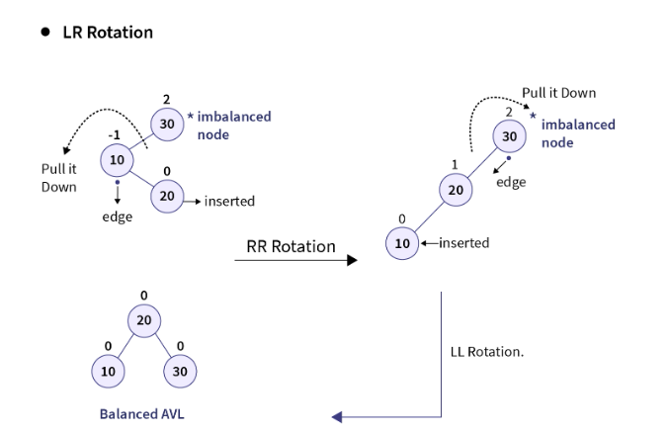
LR Rotation in AVL tree
An imbalance arises when a node is inserted into the right subtree of the left child of a node that is already imbalanced.
Notes:
New Courses replaced with New Programmes

Slide 17
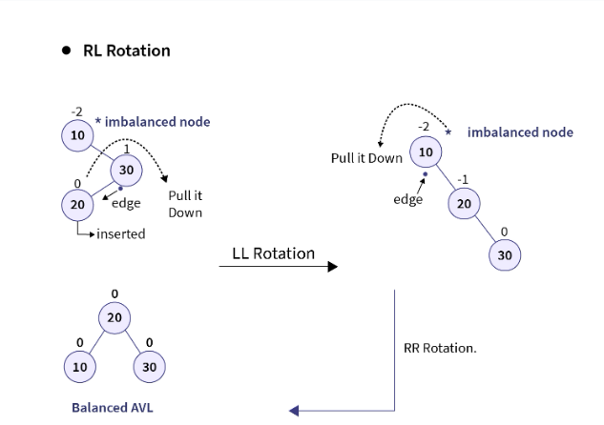
RL Rotation in AVL tree
It is performed when the tree gets unbalanced, upon insertion of a node into the left subtree of the right child of the imbalance node i.e., upon Right-Left (RL) insertion instead of LR insertion.
Notes:
New Courses replaced with New Programmes

Slide 18
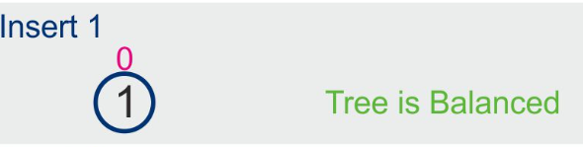
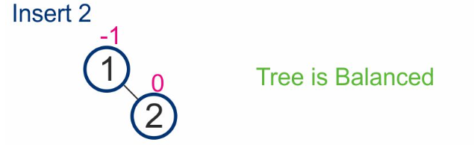
Example of Insertion in AVL tree
Construct an AVL Tree by inserting numbers 1,2,3,4,5,6.
Step 1:
Step 2:
Notes:
New Courses replaced with New Programmes

Slide 19
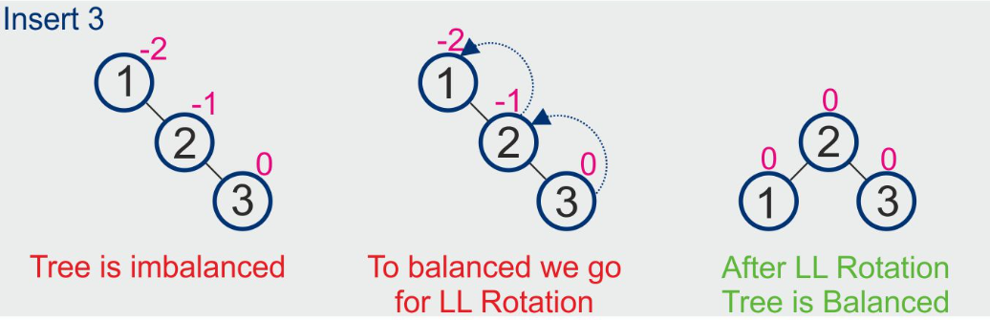
Example of Insertion in AVL tree
Construct an AVL Tree by inserting numbers 1,2,3,4,5,6.
Step 3:
Notes:
New Courses replaced with New Programmes

Slide 20
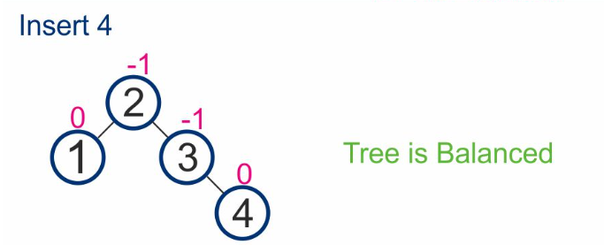
Example of Insertion in AVL tree
Construct an AVL Tree by inserting numbers 1,2,3,4,5,6.
Step 4:
Notes:
New Courses replaced with New Programmes

Slide 21
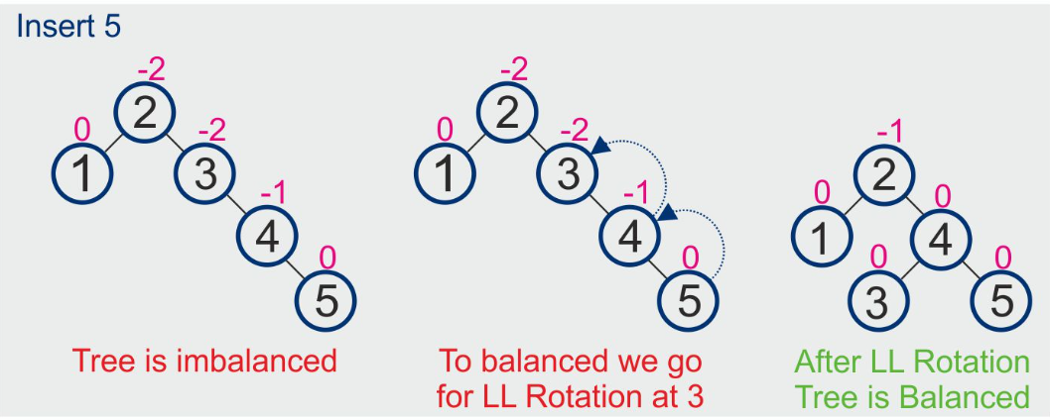
Example of Insertion in AVL tree
Construct an AVL Tree by inserting numbers 1,2,3,4,5,6.
Step 5:
Notes:
New Courses replaced with New Programmes

Slide 22
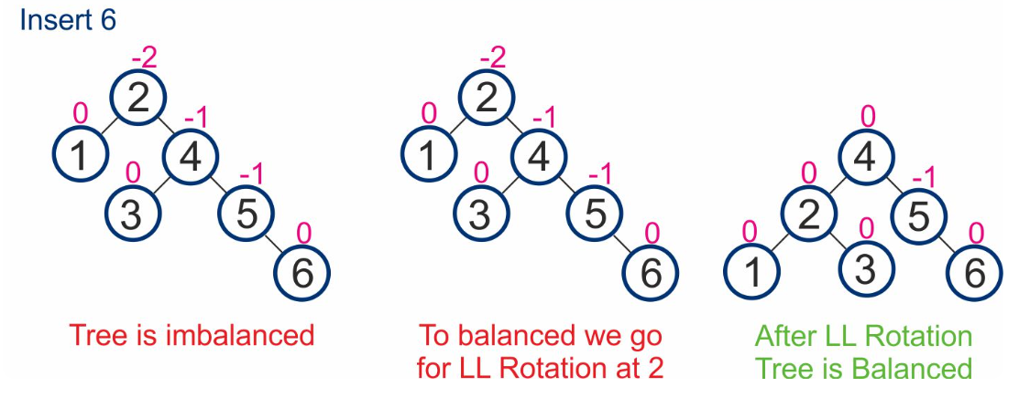
Example of Insertion in AVL tree
Construct an AVL Tree by inserting numbers 1,2,3,4,5,6.
Step 6:
Notes:
New Courses replaced with New Programmes

Slide 23
Deletion in AVL tree
1. Delete Like a BST: Remove the node as in a standard BST. There are three cases:
Node with No Child: Simply remove the node.
Node with One Child: Remove the node and replace it with its child.
Node with Two Children: Find the in-order successor (smallest node in the right subtree) or in-order predecessor (largest in the left subtree), copy its value to the node, and delete the successor/predecessor.
Notes:
New Courses replaced with New Programmes

Slide 24
Deletion in AVL tree
2. Check for Balance: After deletion, walk back up the tree checking the balance factor of each node.
3. Rotate if Necessary: If any node is unbalanced (balance factor of -2 or 2), perform rotations as in the insertion case to balance the tree.
Notes:
New Courses replaced with New Programmes

Slide 25
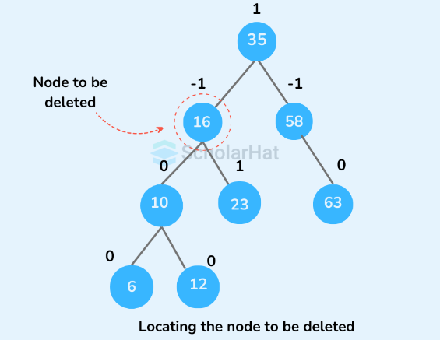
Example of Deletion in AVL tree
Delete the element having value 16 from the AVL Tree
Step 1:
Notes:
New Courses replaced with New Programmes

Slide 26
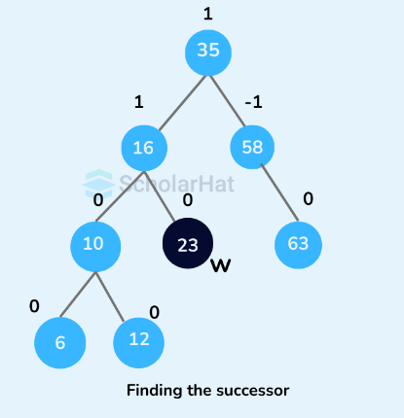
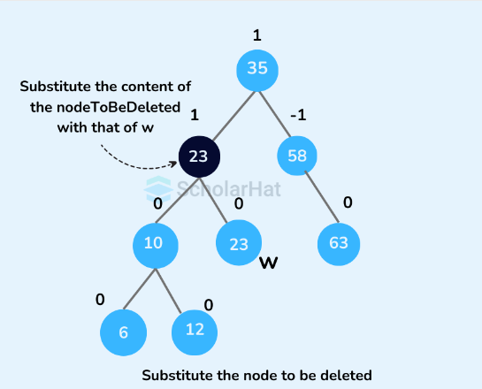
Example of Deletion in AVL tree
Step 2:
Step 3:
Notes:
New Courses replaced with New Programmes

Slide 27
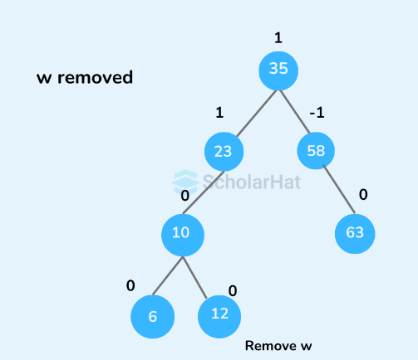
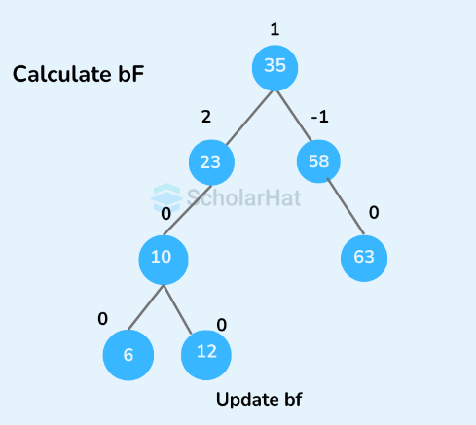
Example of Deletion in AVL tree
Step 4:
Step 5:
Notes:
New Courses replaced with New Programmes

Slide 28
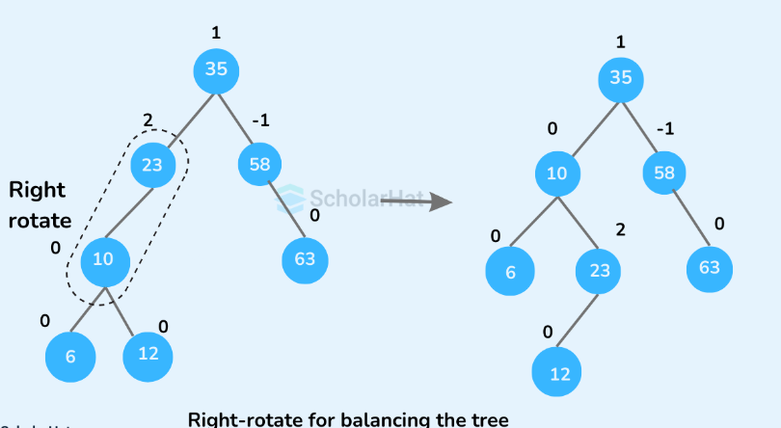
Example of Deletion in AVL tree
Step 6:
Notes:
New Courses replaced with New Programmes

Slide 29
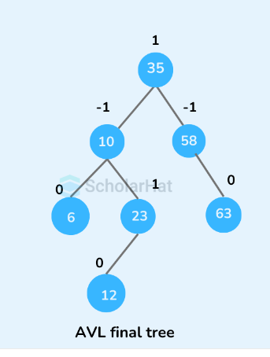
Example of Deletion in AVL tree
Step 7:
Notes:
New Courses replaced with New Programmes

Slide 30

Insert a Node in AVL Tree
Define the structure for a node in the AVL tree
struct TreeNode
{ int data;
TreeNode* left;
TreeNode* right;
int height;
}
Access the Complete Code :https://www.onlinegdb.com/zRvtAlEI-

Slide 31
Insert a Node in AVL Tree
Function to get the balance factor of a node
int getBalance(TreeNode* node)
{
if (node == nullptr)
{
return 0;
}
return getHeight(node->left) - getHeight(node->right);}
Access the Complete Code :https://www.onlinegdb.com/zRvtAlEI-

Slide 32
Insert a Node in AVL Tree
Function to insert a node in the AVL tree
TreeNode* insertNode(TreeNode* node, int value)
{ // 1. Perform the normal BST insertion
if (node == nullptr)
{
return new TreeNode(value);
}
if (value < node->data)
{ node->left = insertNode(node->left, value);
}
else if (value > node->data)
{ node->right = insertNode(node->right, value);
}
else
{ // Duplicate values are not allowed in AVL tree return node; }
Access the Complete Code :https://www.onlinegdb.com/zRvtAlEI-

Slide 33
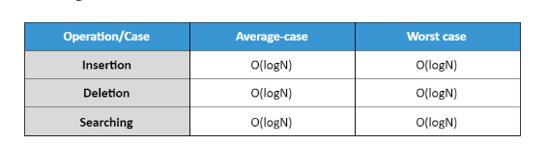
Time Complexity Analysis
Notes:
New Courses replaced with New Programmes

Slide 34
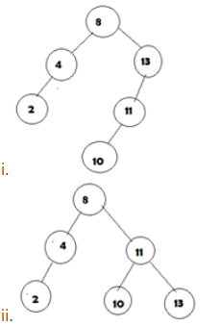
Test Your Knowledge
Q1 Which of the below diagram is following AVL tree property?
a) only i b) only i and ii c) only ii d) i is not a binary search tree
Answer (B)
Notes:
New Courses replaced with New Programmes

Slide 35
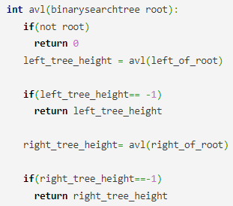
Test Your Knowledge
Q2 Given an empty AVL tree, how would you construct AVL tree when a set of numbers are given without performing any rotations? a) just build the tree with the given input b) find the median of the set of elements given, make it as root and construct the tree c) use trial and error d) use dynamic programming to build the tree
Answer (B)
Q3 Consider the pseudo code:Does the above code can check if a binary search tree is an AVL tree?
a) only i b) only i and ii c) only ii d) i is not a binary search tree
Answer (B)
Notes:
New Courses replaced with New Programmes

Slide 36
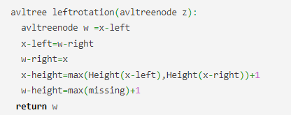
Test Your Knowledge
Q4 Consider the below left-left rotation pseudo code where the node contains value pointers to left, right child nodes and a height value and Height() function returns height value stored at a particular node.
What is missing? a) Height(w-left), x-height b) Height(w-right), x-height c) Height(w-left), x d) Height(w-left)
Answer (A)
Notes:
New Courses replaced with New Programmes

Slide 37
Test Your Knowledge
Q5 How many rotations are required if following elements are added in a sequence :
35,50,40,25,30,60,78,20,28
2 LR and 2 RL
2 LR and 3 RL
3 LR and 3 RL
3 LR and 1 RL
Answer (C)
Q6 What is the maximum height of any AVL-tree with 7 nodes? Assume that the height of a tree with a single node is 0.
2
3
4
5
Answer (B)
Notes:
New Courses replaced with New Programmes

Slide 38
REVIEW
An AVL tree is an height balanced binary search tree in which each node is associated with a balance factor
The balanced factor should be -1, 0 or +1. Otherwise, the tree will be considered an unbalanced tree.
Notes:
New Courses replaced with New Programmes

Slide 39
References
https://www.youtube.com/watch?v=oSWTXtMglKE
https://www.upgrad.com/blog/5-types-of-binary-tree/
https://www.javatpoint.com/tree
https://www.geeksforgeeks.org/tree-data-structure/
https://www.sanfoundry.com/1000-data-structure-questions-answers/
https://www.tutorialspoint.com/data_structures_algorithms/array_data_structure.htm
https://www.tutorialspoint.com/data_structures_algorithms/tree_data_structure.htm
https://www.simplilearn.com/tutorials/data-structure-tutorial/trees-in-data-structure
https://www.scaler.com/topics/data-structures/tree-data-structure/
Notes:
New Courses replaced with New Programmes

Slide 40
THANK YOU

